Slide 1

Distributed Denial of Service Attacks
Amit Kumar Jaiswal
PhD student Researcher. Lecturer-researcher , 2 course Group A01-305b
Department of Intelligent Information Systems and Technologies

Slide 2
Introduction
What is a Denial of Service attack?
  Using up resources and / or bandwidth of a server in a malicious way to prevent legitimate users from accessing its services.
What is a DDoS?
  A DoS attack carried out using a large number of compromised systems improving its potency and reducing traceability of the originator.
Some common DoS methodologies
  SYN flood – exploits poor implementation of TCP in some OSs.
  Ping of Death – uses inherent weakness in IP fragmentation and reassembly
Notorious DDoS attacks
  MyDoom
  Smurf attack

Slide 3
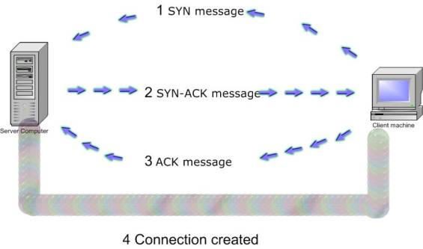
SYN Flood methodology

Slide 4
Ping of Death
Maximum legal size of IP packets is 65535 bytes.
Because of limitations in the physical layer, packets may have to be fragmented and then reassembled at the destination.
A fragmented packet with the maximum offset and size greater than 7 bytes will cause the server to allocate a buffer of size > 65535 bytes.

Slide 5
Distributed DoS attacks
Involves using some common DoS methodology, but the attack is carried out from a large number of machines
IP spoofing is a common technique used in almost all forms of attack.
Botnets consist of a large number of “zombie” machines controlled by a single user which can be used to carry out all sorts of attacks (including DDoS)
Network and protocol implementation loopholes can also be used for launching such attacks

Slide 6
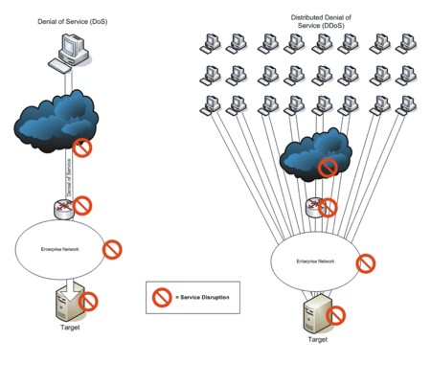
Distributed DoS attacks (contd.)
© Copyright 2008, WSTA, All Rights Reserved.

Slide 7
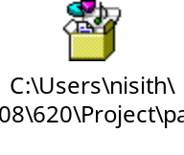
Notorious Attacks
Smurf attack:
  A simple C program which spoofs the targets IP address and sends a broadcast ECHO (ICMP) message. All machines receiving the broadcast message ping the target machine, causing a massive DoS.
  MyDoom: Fastest spreading email worm. On execution, opened a backdoor on the TCP 3127 port and could then be used to run DDoS attacks on specific domains. The affected domains were sco.com, microsoft.com, Google, AltaVista and Lycos

Slide 8
Techniques to mitigate Security Threats
Access Lists
NAT

Slide 9
Access Lists
Introduction
  Purpose of Access Lists
  Need for Access Lists
Definition
  List of conditions

Slide 10
Detecting DOS attacks
How to determine if your system is under attack?
Show CPU utilization
Access-lists implementation

Slide 11
Commands (some examples)
access−list 111 permit ip 172.16.0.0 0.0.255.255 any
access−list 111 deny ip any any log
Interface serial 0/1
ip access−group 111 out

Slide 12
Prevention of DOS attacks
Cisco product ASA
Will be demonstrated in the simulation

Slide 13
Attacks mitigated by ALs
IP address spoofing
DOS smurf attacks
DOS sync attacks
Filtering traceroute

Slide 14
Network Address Translation
“Network Address Translation also known as IP Masquerading or NAT, is an Internet standard that enables translation of IP addresses used within one network to different IP addresses known within another network”

Slide 15
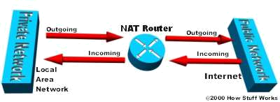
Need for NAT
Shortage of IP addresses with protocol IPv4
-IP address is a unique 32 bit number
-100 million of hosts & 350 million of users
-NAT comes into picture requires only single
IP address to represent a group of computers.

Slide 16
Types of NAT
Basic NAT :
Involves IP translation only - not port mapping
PAT (Port Address Translation):
Involves translation of both IP addresses & port numbers.
  SNAT : Translation of Source IP address & port number
  DNAT: Translation of Destination IP address & port number

Slide 17
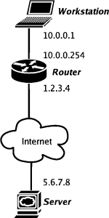
NAT Configuration

Slide 18
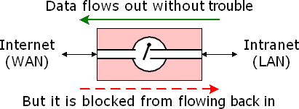
NAT Security Capabilities
Basic NAT acts as firewall between Internet & local Intranet, protects Intranet from Denial of service attack.
NAT routers having advanced firewall implements stateful packet inspection which allows filtering of unnecessary data like IP spoofing, SYN flooding from your router.
NAT router supporting port forwarding keeps unwanted traffic away from your local network.

Slide 19
References
www.windowsecurity.com
http://en.wikipedia.org
Risk mitigation & threat management: compliance, security, and DDoS prevention : by Andreas M. Antonopoulos and Johna Till Johnson
http://computer.howstuffworks.com/nat.htm
http://nislab.bu.edu/sc546/sc441Spring2003/NAT/index.htm
http://en.wikipedia.org/wiki/Network_address_translation
http://www.ipv6.com/articles/nat/NAT-In-Depth.htm

Slide 20


